Slide 1
Hypothesis testing
Gedi Lukšys
Applied Data Science 2
October 28, 2019

Slide 2
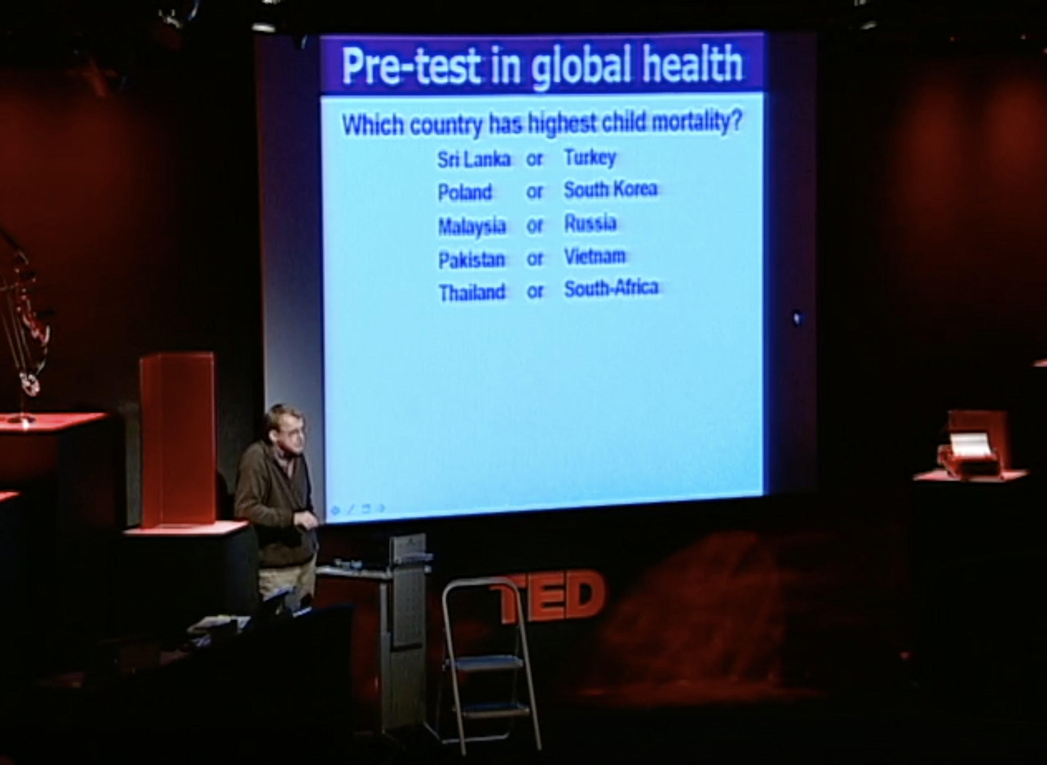
Example:
https://www.ted.com/talks/hans_rosling_shows_the_best_stats_you_ve_ever_seen

Slide 3
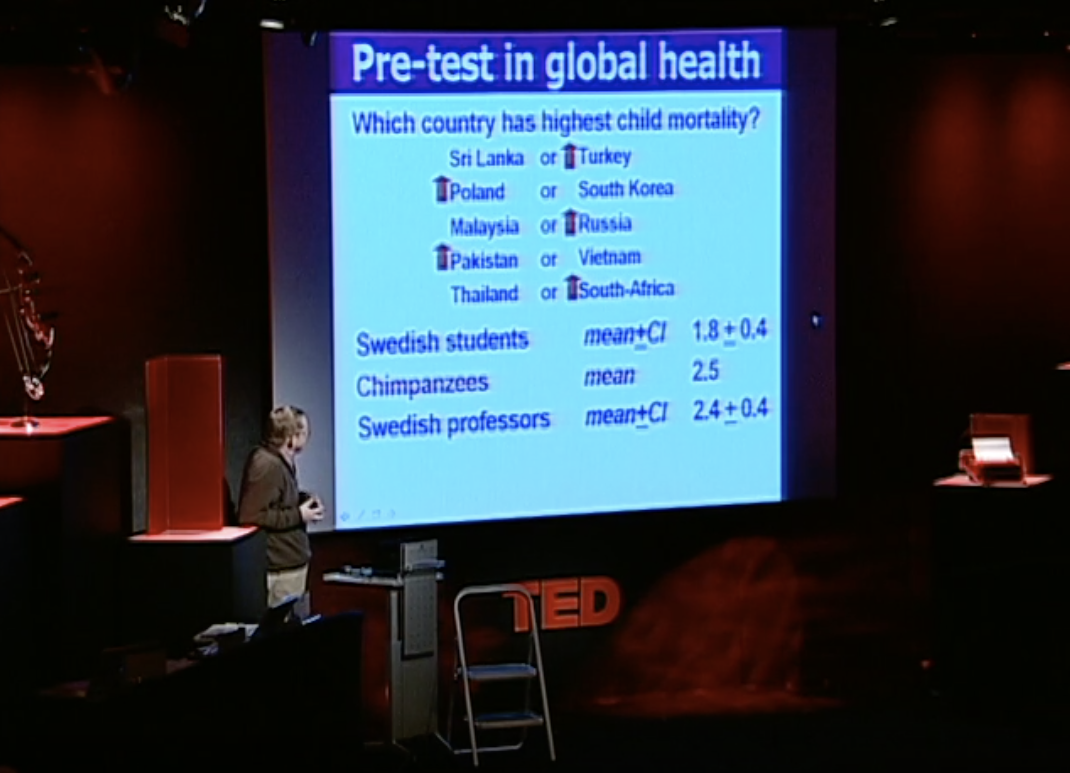
Example:
https://www.ted.com/talks/hans_and_ola_rosling_how_not_to_be_ignorant_about_the_world

Slide 4
Procedure of hypothesis tests
Formulate the Null Hypothesis, Alternative Hypothesis
Design your experiment and collect data
Summarise and describe your data
Think about what you would expect if H₀ were true.
Could your data be explained by the Null Hypothesis?
Determine the probability of your data given H₀
Interpret your p value and make a decision
Be aware that hypothesis tests are not perfect

Slide 5
Null and alternative hypotheses
Null hypothesis: nothing is happening
In our example: Swedish students are able to distinguish child mortality between countries where it differs with ratio 2:1 same as chimpanzees
Alternative hypothesis: something is happening
In our example: Swedish students are able to distinguish child mortality between countries where it differs with ratio 2:1 worse than chimpanzees
T-test p < 10⁻⁵ => reject null hypothesis

Slide 6
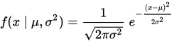
Statistical models: what are they?
Extract patterns from available data (training data)
Can be used to predict new data (testing data)
Are all wrong…
…but some are useful! (George Box)
What are their main elements?
The generating process, e.g. y = f(x)
Parameters that control it, e.g.

Slide 7
Null and alternative hypotheses – formally speaking
Null hypothesis: no difference between two parameters or a parameter and a constant
Alternative hypothesis: difference between two parameters or a parameter and a constant
Types of tests
Two-tailed: can be less or more (default)
One-tailed (need to be justified):
One should be bigger than the other (right tailed)
One should be smaller than the other (left tailed)

Slide 8
Other examples: null
Null Hypothesis (H₀): “Nothing is happening”
The effect of the medication is the same as that of a placebo.
Lack of sleep does not affect cognitive function.
Wildtype mice and FMRP knockout mice show the same level of synaptic activity.
Rates of TB infection have not changed between 1920 and 2010.

Slide 9
Other examples: alternative
Null Hypothesis (H₀): “Nothing is happening”
The effect of the medication is the same as that of a placebo.
Lack of sleep does not affect cognitive function.
Wildtype mice and FMRP knockout mice show the same level of synaptic activity.
Rates of TB infection have not changed between 1920 and 2010.
Alternative hypothesis (H_{A}): “Something is happening”
The medication has a different effect than a placebo.
Lack of sleep affects cognitive function.
Wildtype mice and FMRP knockout mice show different levels of synaptic activity.
Rates of TB infection changed between 1920 and 2010.

Slide 10
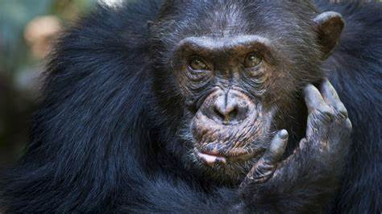
Statistical tests: the procedure
Use data obtained from sample(s) to make a decision whether or not to reject the null hypothesis
Swedish students sample:
2 1 2 2 1 2 1 2 2 1 2 2 1 2 3 2 2 2 2 2
Swedish professors sample:
2 3 2 3 2 3 2 2 2 2 3 2 3 2 3 2 3 2 2 3
Chimpanzees?
Presumably
50-50!...
https://media.treehugger.com/assets/images/2011/10/psychic-german-octopus-world-cup-football.jpg
https://www.naturalworldsafaris.com/wildlife/chimpanzees
Really? ☺

Slide 11
Example: t-tests
Swedish students sample:
2 1 2 2 1 2 1 2 2 1 2 2 1 2 3 2 2 2 2 2
Swedish professors sample:
2 3 2 3 2 3 2 2 2 2 3 2 3 2 3 2 3 2 2 3
Chimpanzees? Presumably 50% chance!...
Students vs. Professors: p = 7 * 10⁻⁴
Students vs. Chimpanzees: p = 9 * 10⁻⁶
Professors vs. Chimpanzees: p = 0.38

Slide 12
What is P value?
Probability of observing a value as or more extreme as the one you observed if the null hypothesis were true.
What do we do with it?
Level of significance – convention (no magic!)
p < 0.05: reject the null hypothesis
p > 0.05: cannot reject the null hypothesis (not the same as confirm it!)

Slide 13
Different outcomes
 | Something is happening | Nothing is happening
We found something | True positive (correct) | False positive (Type 1 error)
We found nothing | False negative (Type 2 error) | True negative (correct)

Slide 14
Type 1 and 2 errors
Where should the critical value be?
https://i1.wp.com/statisticsbyjim.com/wp-content/uploads/2018/07/TypesErrorHypothesisTests.png?fit=600%2C400

Slide 15
Critical values and critical regions
Significance level need not always be 0.05!
https://image.slidesharecdn.com/statisticshypothesistesting-130115004420-phpapp02/95/statistics-hypothesis-testing-14-638.jpg?cb=1358210733

Slide 16
Hypothesis testing steps
Formulate a hypothesis
Choose a significance level
Calculate the critical value
Calculate the test statistic
Calculate p value
Make a decision
Buridan’s Donkey
https://mayooshin.com/wp-content/uploads/2018/11/boridans-ass.jpg

